Slide 1

Module 0
Where to Run Python Code?
Notes:
Guidelines
Use section headers to chunk content in your presentation.
Use the same style of section header throughout your presentation.
Keep your title to no more than 2 lines.

Slide 2
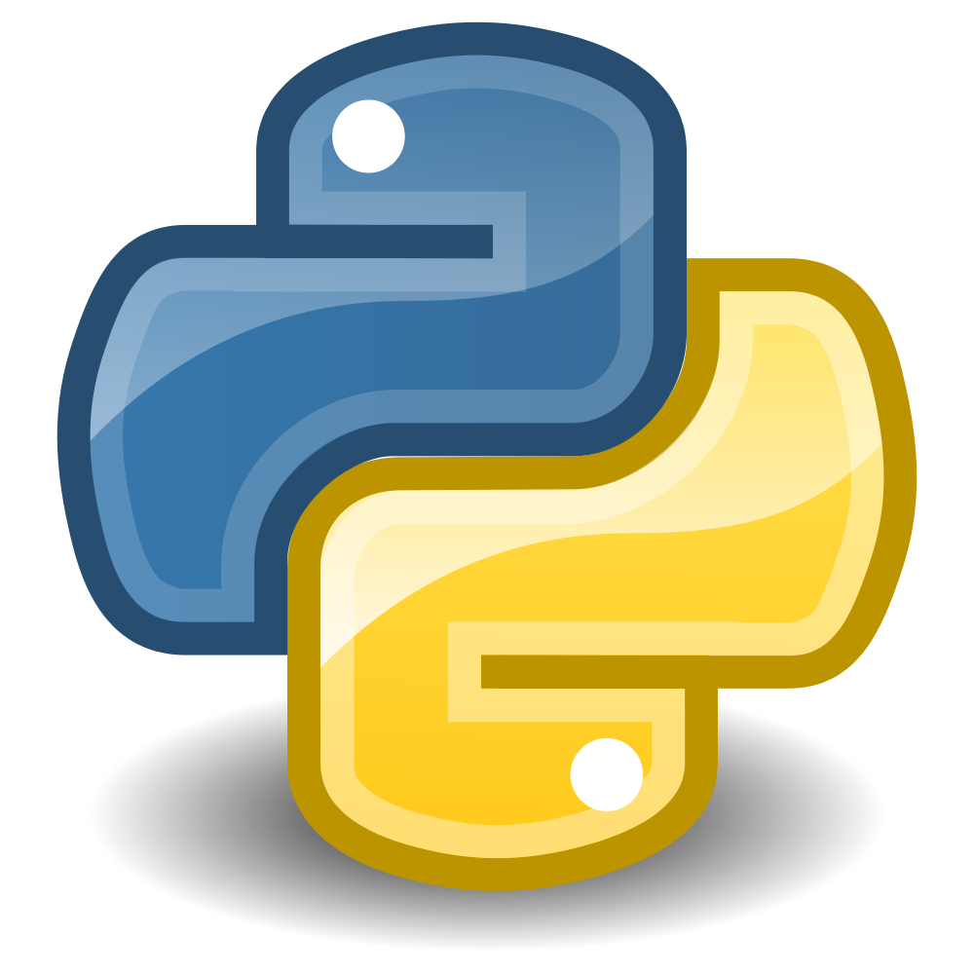

Anaconda
Installation
Notes:
Guidelines
Use a title slide at the beginning of your presentation. There are 9 variations of title slides to choose from.
If you will have a series of slideshows, we recommend using the same style of title slide for each presentation.
Keep your title to no more than 2 lines.
Do not change the font style or font size of the title or subtitle.

Slide 3
Anaconda
Distribution of Python that includes most of the libraries and modules.
NumPy
Pandas
Matplotlib
Sklearn
Link: https://www.anaconda.com/download

Slide 4
Jupyter Notebooks
Working with Notebooks
Notes:
Guidelines
Use a title slide at the beginning of your presentation. There are 9 variations of title slides to choose from.
If you will have a series of slideshows, we recommend using the same style of title slide for each presentation.
Keep your title to no more than 2 lines.
Do not change the font style or font size of the title or subtitle.

Slide 5
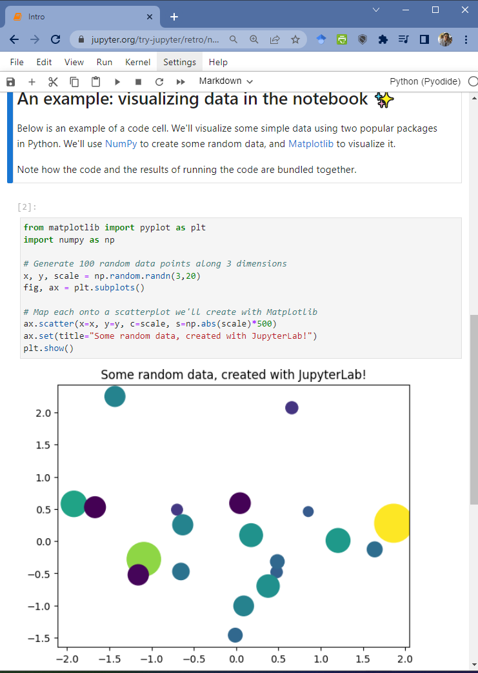
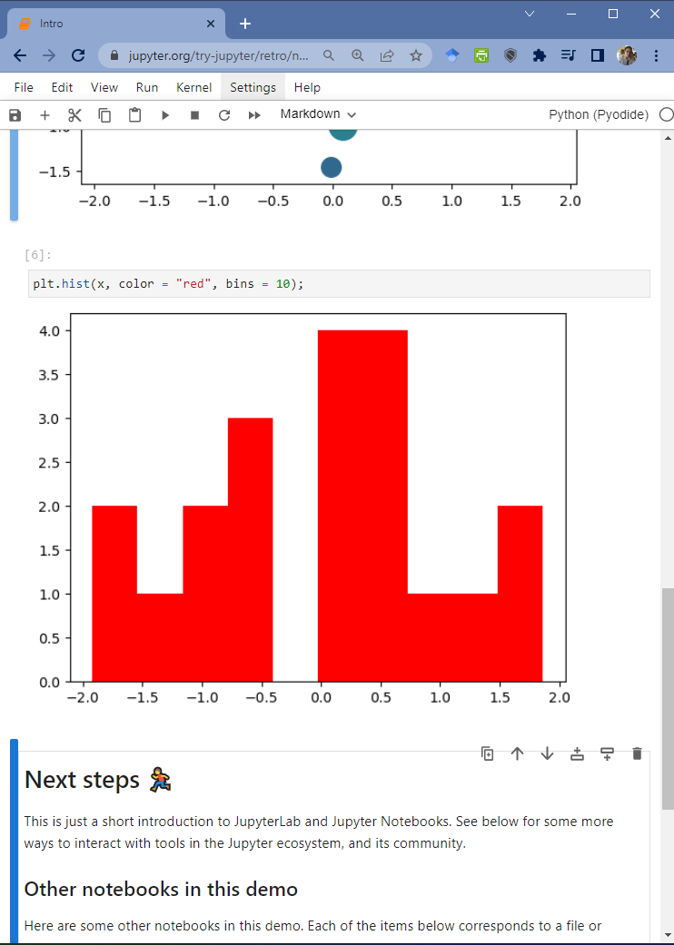
Jupyter Notebooks
Allows to write Python code in web browser
Useful for replicating and explaining code
Allows user to easily modify, add, delete cells

Slide 6

Practice
Notes:
Use this slide for graphics, tables, or images that are white in color.

Slide 7

Google Colab
Creating Colab Notebooks
Notes:
Guidelines
Use a title slide at the beginning of your presentation. There are 9 variations of title slides to choose from.
If you will have a series of slideshows, we recommend using the same style of title slide for each presentation.
Keep your title to no more than 2 lines.
Do not change the font style or font size of the title or subtitle.

Slide 8
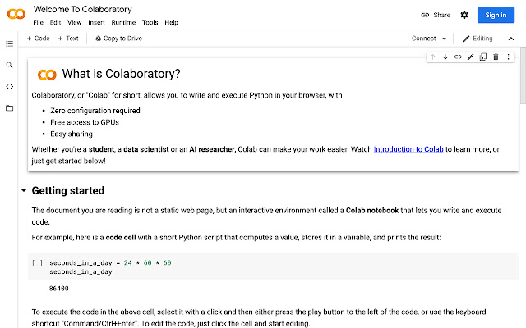
Google Collaboratory (Colab)
Allows you to run Python notebooks on remote computer
Complete installations of Python and ML modules
Allows users to use GPUs and TPUs for faster computations

Slide 9
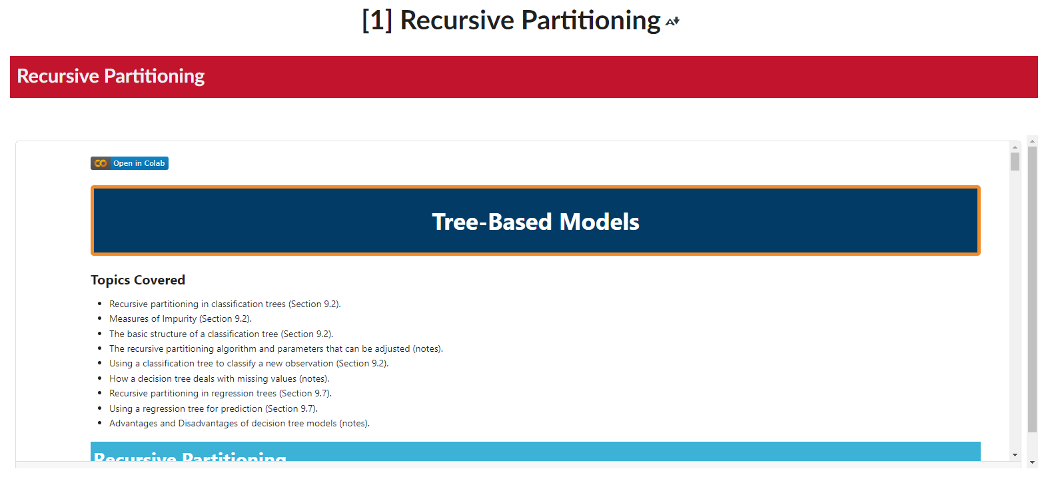
Google Collaboratory (Colab)
Course Notes a written in Google Colab

Slide 10
Practice

